Slide 1
POWER
DISTRIBUTION
NETWORK
ENGR. ADEOLU TAIWO

Slide 2
Electrical distribution systems are an essential part of the electrical power system.
In Nigeria, Distribution networks are designed as passive systems, which provides one-directional links between the transmission network and electricity end users. Most of the radiating feeders are radial networks and very few ring networks.

Slide 3
DISTRIBUTION SYSTEM
In Nigeria, the distribution system may be divided into:
Primary Distribution: 33kV network.
Secondary Distribution: 11kV Network.
Tertiary Distribution: 400V – 3 phase and 230V – 1 phase.

Slide 4
The conductors in the distribution system may be grouped under the headings:
Primary Feeders- 33kV lines: their sole purpose is to evacuate bulk power from transmission stations to injection sub-stations.
Secondary Feeders-11kV lines: Connecting the injection sub-stations to the load areas usually terminating in distribution transformer sub-stations.
Distributors- 400V (lines): Connecting the distribution transformers to the load areas by 4 wires, 3 – phase overhead lines/underground cables.
Service mains- are the connecting links between the distributors and the consumers meter terminals.

Slide 5
The type of supply to be provided for any consumers premises in each depends on several factors;
The available grid system
The type of premises
The desired load
The distance involved
Safety of the people around

Slide 6
There are two fundamental types of distribution schemes:
Radial system.
Network system (also called the Ring system, Mesh or Loop system)

Slide 7
Radial System
A radial system has a single simultaneous path to power flow to the load. Economical for a small and widely sparse network but with low degree of reliability hence service continuity cannot be guaranteed.
Note: RADIAL – All loads after line of fault will be affected

Slide 8
A ring system has more than one simultaneous path to power flow to the load. A ring network is fed by more than one feeder as compared to radial fed from one feeder.
Ring system offers the highest degree of reliability and service continuity.
Note: Line fault at one point does not affect other loads.
Ring system

Slide 9
We have two types of Distribution networks:
Overhead Distribution Network
Underground Distribution Network

Slide 10
Overhead Distribution network
Overhead distribution network is an electrical network where the electrical conductors are erected on structures in the open to distribute power supply to energy consumers or users.

Slide 11
ROUTE SURVEY
Produce a survey plan and profile of the route. NESIS 5.1.1
What to consider during the route survey?
Topography, type of soil, type of settlement, type of connections etc
Is the construction within the Township or an Inter-township connection?

Slide 12
TOWNSHIP DISTRIBUTION NETWORK (TDN) |  | SPAN LENGTH
Type of Construction | Conductor Type and Size | Min (m) | Max (m)
LV (400V) | 70mm², 100mm², AAC | 45 | 50
HV/LV (33/11/0.4kV) | 70mm², 100mm², 150mm², AAC 100mm², 150mm², ACSR | 45 | 50
HV (11kV) | 100mm², 150mm², AAC, ACSR | 45 | 50
HV (33kV) | 150mm², ACSR | 45 | 50

Slide 13
INTER-TOWNSHIP CONNECTION (ITC) |  | SPAN LENGHT
Type of Construction | Conductor Type and Size | Min (m) | Max (m)
HV (11kV) | 100mm², 150mm², AAC, ACSR | 50 | 70
HV (33kV) | 150mm², 200mm², ACSR | 50 | 70

Slide 14
WHAT SHOULD BE CONSIDERED WHEN DESIGNING AN OVERHEAD DISTRIBUTION LINES: NESIS 5.1
Materials
Environmental issues
Mechanical loading conditions
Electrical service conditions and physical environment
Prevention of unauthorized access.

Slide 15
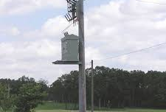
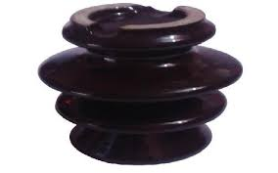
Materials:
The components, accessories, and support structures

Slide 16
Environmental Issues:
The social impact of new projects, and community concerns,
The minimization of environmental damage, including visual impacts, tree and forestry management programmes,
The consideration of Electromagnetic radiation.
Erosion prone environment.

Slide 17
Mechanical Loading Conditions
Mechanical and structural strength to withstand anticipated stresses and strains due to environmental and electrical service conditions.

Slide 18
Electrical Service Conditions and Physical Environment
In determining the electrical service conditions and the physical environment under which the electrical works will operate, reasonable care shall be given to the consideration of extremes that may occur, the likelihood of their occurrence and the associated risks.

Slide 19
Prevention of Unauthorized Access
All electrical works with exposed live parts shall be designed and constructed in such a manner as to prevent unauthorized access to any person as far as is reasonably practicable.

Slide 20
OVERHEAD LINES (33/11/0.4 kV)
Main Components of overhead Lines:
This Photo by Unknown Author is licensed under CC BY-SA

Slide 21
SUPPORTS:
Treated wooden poles
Concrete poles
Lattice steel poles

Slide 22
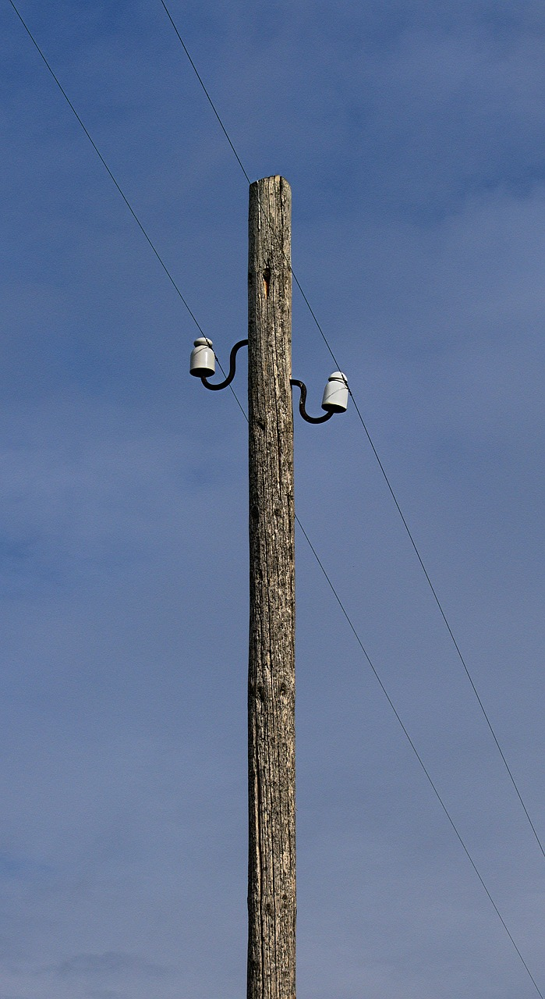
TREATED WOODEN POLES:
Treated wooden poles made from Opepe tree are exceptionally good and strong as support structure in distribution overhead lines.

Slide 23
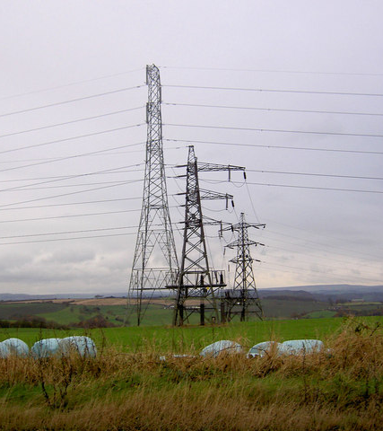
Lattice Poles:
Poles made from galvanized steel.
This Photo by Unknown Author is licensed under CC BY-SA

Slide 24
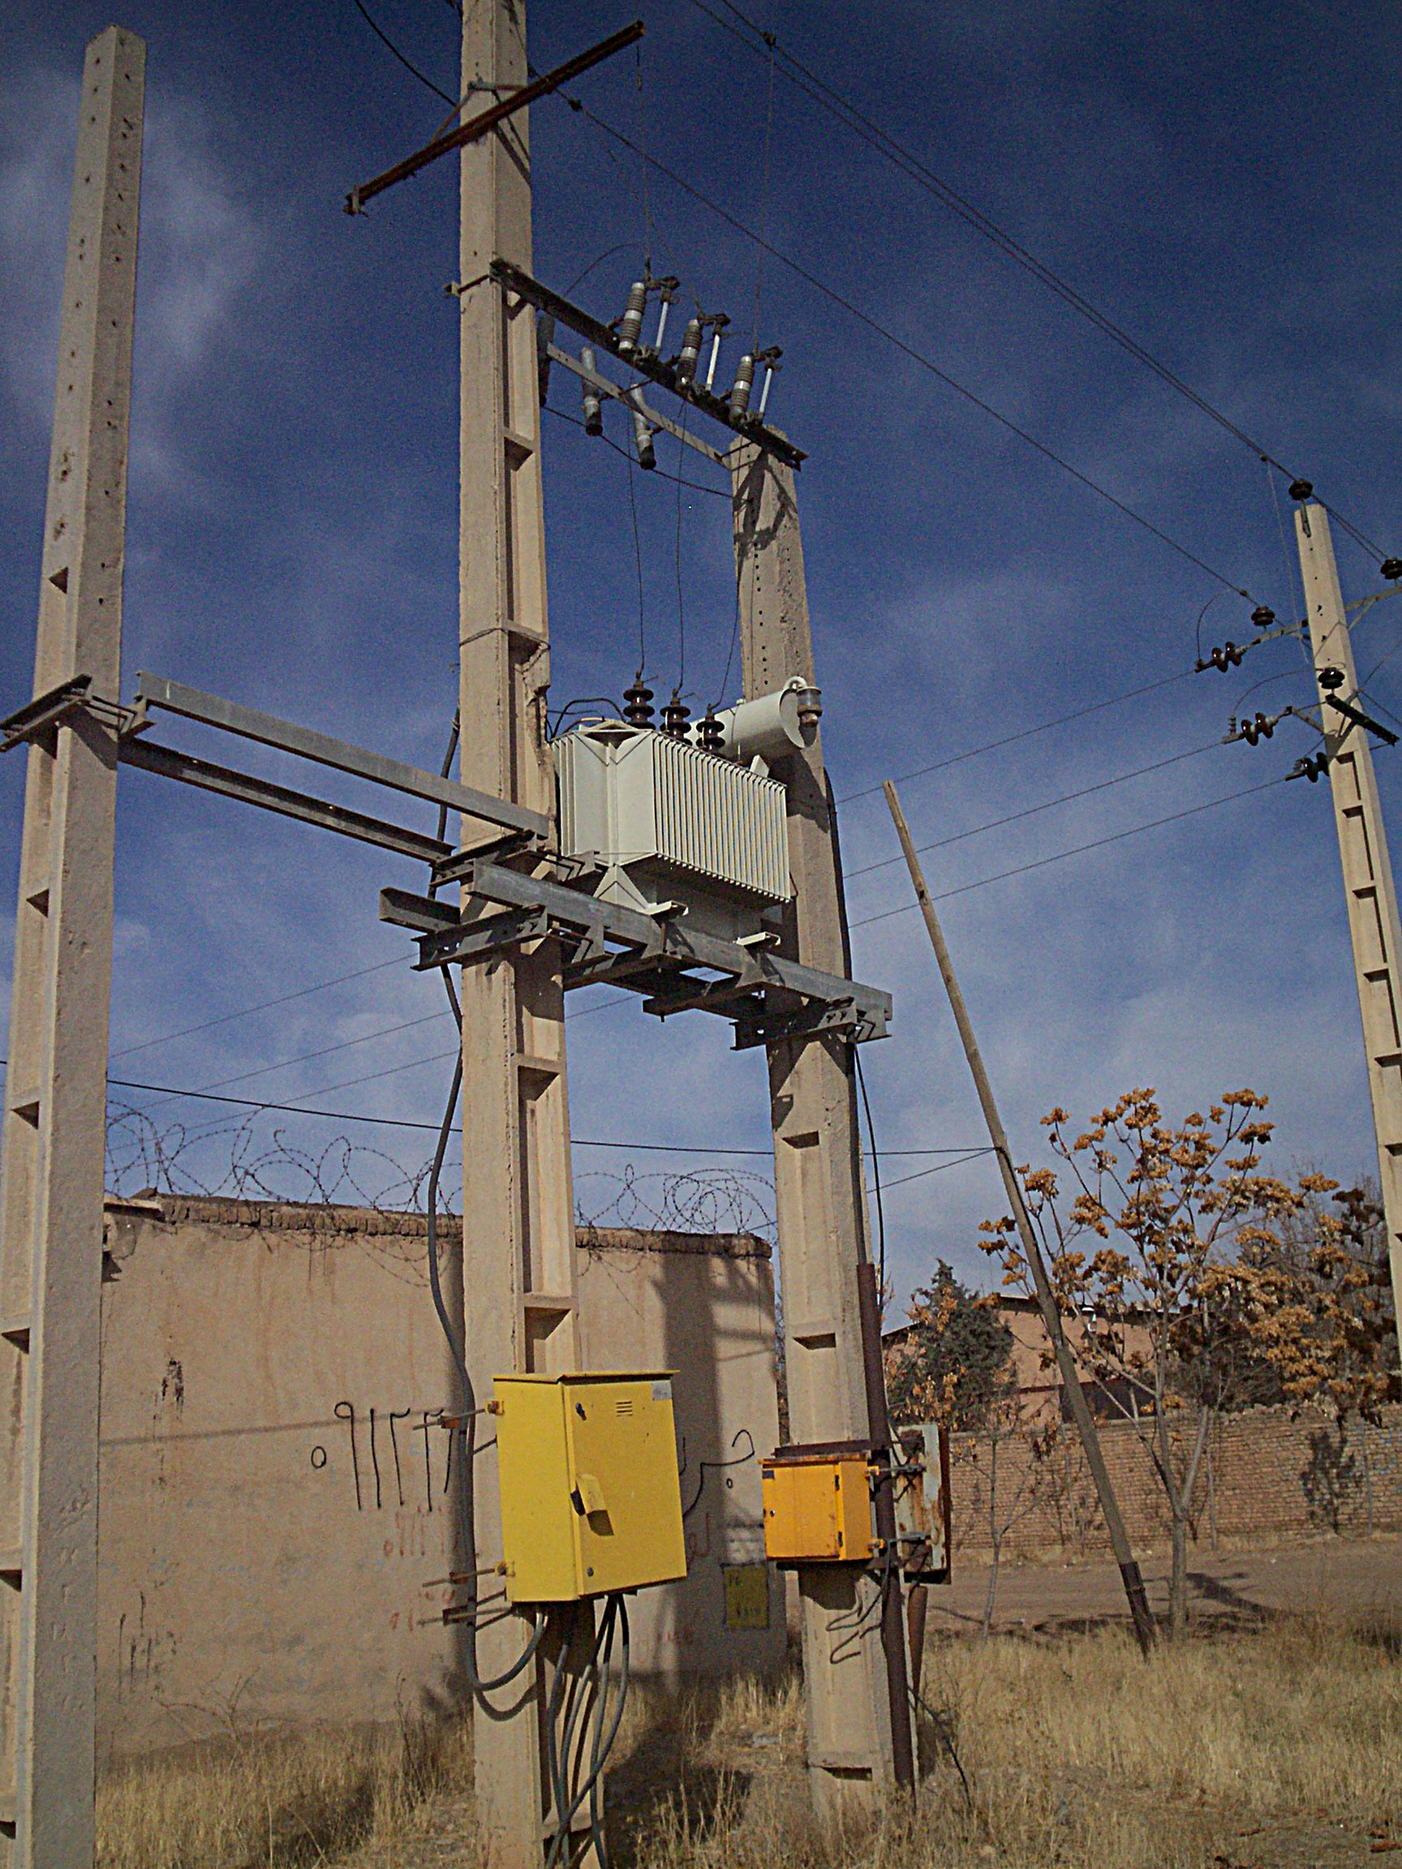
CONCRETE POLES:
We have two types of concrete poles in Nigeria: Pre-stressed and Reinforced concrete poles.
This Photo by Unknown Author is licensed under CC BY-SA

Slide 25
S/N | Line type | Pole height (m) | Pole Planting depth (m)
1 | LV (400V) | 8.54 | 1.2
2 | LV & HV (33/11/0.4kV) | 10.36 | 1.8
3 | HV (33/11kV) | 10.36 12.20 | 1.8 2.1
4 | 33kV Double circuit | 12.20 | 2.1

Slide 26
Pole identification:
All poles must have a legible engraved identification mark showing its NEMSA No. Batch No, Planting depth mark. They must be numbered.

Slide 27
CROSS ARMS
Cross arms can be an approved treated wood, galvanized mild steel (U-channel) or fibre that is mounted on an electric pole to hold up power lines or other electrical equipment. They are used for anchoring and supporting conductor distribution lines.

Slide 28
Types of cross arms:
Treated wooden cross arm
Galvanized cross arm ( U-Channel and Angle galvanized steel)
Fiber Cross arm.

Slide 29
Cross arm length based on voltage level
Voltage level (kV) | Length (mm)
11 | 1800
33 | 2700

Slide 30
INSULATORS FOR OVERHEAD LINES
Electrical insulators are materials that have tightly bound electrons whose internal electric charges do not flow freely; little electric current will flow through it under the influence of an electric field.

Slide 31
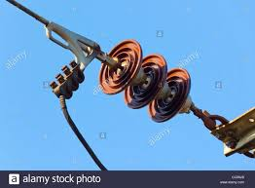
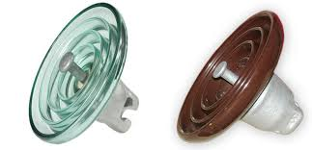
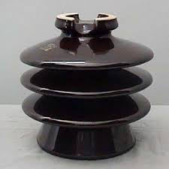
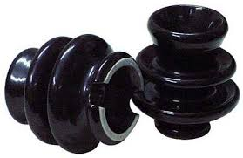
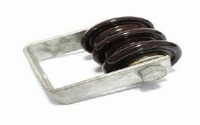
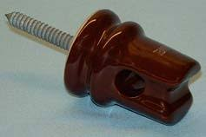
Types of insulators:
Shackle's insulators – 400V
Coach Screw service Insulators – 400V
Pin Insulator – 11kV or 33kV
String Insulator – 11kV or 33kV

Slide 32
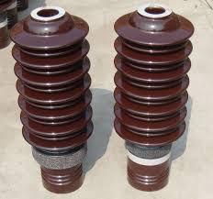
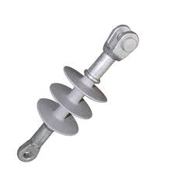
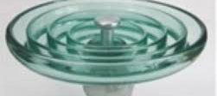
Types of insulators materials:
Porcelain
Glass
Silicon

Slide 33
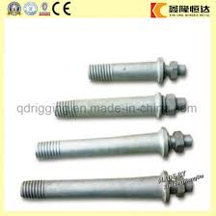
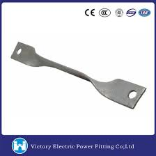
Tie Straps.
Spindle
Ball ended hook
Ball clevis
Socket clevis

Slide 34
Conductors:
Conductors are the materials or substances which allow electricity to flow through them. They conduct electricity because they allow electrons to flow easily inside them from atom to atom.
Conductors approved for sub-transmission primary lines (33kV) is Aluminum Conductor Steel Reinforced

Slide 35
S/N | Type of Construction | HV Conductor |  | LV Conductor |  | Current Carrying Capacity (A)
1 | Combine 11kV and LV Circuits on concrete poles | HD AL, AAC | 100 150 | HD AL, AAC | 50 100 150 | 180 270 345
2 | 11kV Single Circuit on Concrete Poles | ACSR, AAC | 100 150 | N/A | N/A | 270 345
3 | 33kV Single Circuit on concrete poles | ACSR | 100** 150 200 | N/A | N/A | 270 345 420
4 | 33kV Double circuit on Concrete poles | ACSR | 150 200 | N/A | N/A | 345 420

Slide 36
HD Al- Hard Drawn Aluminum
AAC – All Aluminum Conductor
ACSR – Aluminum Conductor Steel Reinforced
N/A – Not applicable

Slide 37
Allowable Voltages in distribution network:
NESIS 5.1.6.i Standard AC voltages
Primary distribution: 33000 ±6%
Secondary distribution: 11000 ±6%
Low Voltage: 400 ±6%

Slide 38
NIGERIAN DISTRIBUTION CODE (NDC). V2. 4.3: VOLTAGE LEVELS
4.3.1. Nominal and Operational Voltages on the Distribution System are shown in the following Table.

Slide 39
NESIS 5.3: Minimum height of conductors
The minimum height of conductors should be considered in design of an overhead distribution line.
NESIS 5.3.1 Clearance of Pole to ground or roads:

Slide 40
NESIS 5.2.12. Jointing Requirements for Overhead Distribution Conductors
Joints between conductors of overhead distribution lines shall be mechanically secure and electrically continuous under the conditions of operation.
There shall be one (1) joint only for new connections;
while two (2) joints may be allowed for existing connections.

Slide 41
Clearance between any overhead transmission conductor and any overhead distribution conductor
System voltage between phases | Clearance (m)
Not exceeding 400V – Insulated | 0.2
Not exceeding 400V – uninsulated | 0.6
Over 400V but not exceeding 33kV | 1.8
Over 33kV but not exceeding 132kV | 2.4

Slide 42
Clearance of electric lines to buildings: electric lines over or adjacent to a building NESIS: 5.3.4.1
Voltage level | Clearance (m)
400V to 11000V | 2.4
33000V | 3

Slide 43
Right of Way: NESIS 3.1
This is the distance of any structure from the middle of the conductors of overhead power lines of any voltage level.
Voltage level (kV) | Right of Way (m) | Middle of conductor to structure (m)
11 | 11 | 5.5
33 | 11 | 5.5

Slide 44
Type of Faults:
Faults on overhead lines fall into one of three categories. They are transient, semi-permanent and permanent. 80-90% of fault on any overhead line network are transient in nature. The remaining 10%-20% of faults are either semi-permanent or permanent.
Transient fault - A transient faults are faults that are expected to be cleared automatically, and these do not require any attempt for fault rectification. It can be like a lightning strike or an insulator flash over that is cleared by tripping of circuit breaker and does not re occur when the line is energized again. E. g, momentary tree contact, bird or other animal contact, lightning strike, and conductor clashing.

Slide 45
Type of Faults:
Semi-permanent faults - are also transient in nature but there take few moments to remove. E g, A branch falling on the line. This kind of fault will not be cleared by subsequent tripping and auto-reclosing, but a time delayed trip will allow the branch to be burned out fully.
Permanent faults – A permanent fault is one which is not cleared by tripping and reclosing. E g, Careless motor vehicle drivers, Operating error: leaving earths connected, Equipment Failure.

Slide 46
DISTRIBUTION SUBSTATION
This is where the transformer switching, and protection equipment are installed. The distribution substation have step down transformers, a few incoming high voltage transmission lines and several outgoing medium voltage overhead lines for underground cables.

Slide 47
DISTRIBUTION SUBSTATION
Distribution substations serve as a source of energy supply for the local areas of distribution in which they are located. There main function is to receive energy transmitted at high voltage, reduce the voltage to a value appropriate for local distribution. They also provide points where safety devices may be installed to disconnect equipment or circuits in the event of fault.

Slide 48
DISTRIBUTION SUBSTATION
THE DISTRIBUTION VOLTAGE LEVELS:
Primary injection substation, ( 33/11kV system)
Distribution substation , (11/0.4/0.23kV system)

Slide 49
Distribution Transformer
Distribution Transformer Capacity ;
25, 50,100, 200, 300, 500kVA respectively
Distribution transformer,
Primary transformer – power ratings of 1 MVA to 7.5 MVA, 33/11kV voltage ratio
Secondary transformer – rated 25kVA to 500kVA, 11/0.4kV or 33/0.4kV voltage ratio

Slide 50
FUSES
Fuses - used for over current protection.
HV - rewireable drop-out expulsion type
LV - high-rupturing capacity (HRC) type.

Slide 51
LIGHTING ARRESTOR
used for over voltage protection to discharge excessive current built upon the line to earth due to over voltages and lightning voltage surges and are mostly outdoor.

Slide 52
CABLES
Cables – used to connect the transformers to the overhead lines and to feeder pillars.
HV cable – Paper insulated, lead covered, steel armoured, PVC sheathed or cross-linked Polyethylene (XLPE) insulated, PVC sheathed.
LV cable – Usually 4-core, polyvinyl chloride (PVC) insulated and sheathed. (PVC/PVC & PVC/SWA/PVC)

Slide 53
Feeder Pillar:
They are distribution transformer cabinet boards used for distribution of power supply to residential and some small-scale commercial consumers in our towns, cities, etc. at 400V and 230V respectively in a safe, economical and convenient way for operational and maintenance purposes. They also have fuse protection (HRC fuses).
It gets its supply from the secondary side of the transformer.

Slide 54
Feeder Pillar:
Have provision for one fused incoming and different number of fused outgoing feeders are called “WAYS” (2,4,6,8, etc.).
While the outgoing units to the LT overhead line are protected with fuses between 50-400A fuses.
NOTE:
Use of under size feeder pillars results in power loss
Use of solid link fuses overstresses the transformer resulting in damage as well as loss of power supply to consumers

Slide 55
Ring Main Unit (RMU):
They are distribution load breaks switches used on voltages up to 40KV to service feeder loads area in compliment of feeder circuit breakers. They have fuses for protection purposes and oil cooled.
But these types have been phased out. The new type is SF₆ type where SF₆ is used as the arc quenching medium instead of oil.
They ensure that there is constant power supply even when there is a problem on any of the legs. They can perform both switching and protection operations.

Slide 56
Line isolator:
Adequate means of isolating a faulty section of the grid system is very important. This aid maintenance and also prevent total shutdown of a town or an area due to a fault occurring on a part of the grid system.
Isolators should be placed at the point of Tee-off of the overhead line or at the terminal pole at the substation.

Slide 57
Transformer and Feeder Pillar Plinths:
These are the mounting bases for the transformer and Feeder pillar. They are made of reinforced concrete so that they can withstand the weight of the transformer or Feeder pillar.
The transformer plinth has a height of 1.2m minimum for external bushing type of the transformer and 0.3m minimum for internal bushing type while the feeder pillar is 0.3m to ensure the base is not too open for easy coverage and protection.

Slide 58
BIMETAL LINE TAP:
Used for the connection of two dissimilar conductors e.g copper and aluminum.
Consequence of not using bi-metal line tap:
Connecting dissimilar conductors without bimetal line tap will cause serious overheating at the joint, melting and subsequent snapping of conductors.

Slide 59
LINE TAP & cable lugs
LINE TAP - used for connecting similar conductors e.g aluminum conductors.
CABLE LUGS – are devices used for connecting cables to electrical equipment/appliances. Their sizes are in line with the sizes of cables they are to be used for, e.g. sizes range from 1.5mm² to 1000mm². There are a lot of fake in the market, so, the Engineer must know the quality cable lugs from fake cable lugs

Slide 60
EARTHING SYSTEM:
The reason for earthing a connection to the general mass of the earth is to ensure or provide a means of ensuring that a path is created for the immediate and safe discharge of fault current to earth so that the protective devices can operate and isolate the faulty circuit.

Slide 61
EARTHING SYSTEM:
The basic reasons for earthing are;
To limit voltages due to lightning strikes
To stabilize the voltage to earth during normal operation
To facilitate the operation of the over current device in case of ground fault.
To limit voltage due to unintentional contact of the supply with higher voltage lines
To limit voltages due to line surges.

Slide 62
Soil Treatment:
Fresh animal dropping should be avoided. The larger the stay of the animal droppings before use, the better the soil improvement. The mixtures are used because they help always retain moisture (H₂O) around the electrodes.
The longer the earth rods, the better the earth values and the better to discharge the earth fault current to ground.
Importance for the soil to be water retentive.
Soil resistivity is lower in the deeper strata of the earth which is reasonably wet all year round.

Slide 63
Protective Multiple Earthing (PME):
This is recommended to ensure the neutral conductor connected to the upriser cables are connected to the general mass of the earth at several location points.
The neutral of the incoming supply also forms the earth return path. It is thus referred upon as earth. It is done to ensure very low resistance in any path of the neutral conductor as much as possible.
It is carried out in accordance with the electricity regulation that is at every 5th pole position from the substation, terminal poles, and open points.

Slide 64
DESIGN AND SAFETY MANAGEMENT Substation design/ construction: checklist;
The location of the substation is very important it must be determined by the strength of the houses in the town.,
It must not be close houses, marketplace, or place of gathering.
If it is close to houses, transformers with internal bushing should be used and more protection provided for the substation,
The size of substation is a minimum of 10 feet X 10 feet,
The transformers should be centralized inside the substation, thus providing rooms for free movement around it and creating a safe work area,

Slide 65
DESIGN AND SAFETY MANAGEMENT Substation design/ construction: checklist;
The transformer plinth for transformers with external bushing is a minimum of 1.2m in height, while the internal bushing should be lower.
The feeder pillar must be placed facing the entrance gate of the substation,
The down drop cables (where PVC/PVC cables are used) must be a minimum of 1.2m in length if it is longer than that, XLPE cables should be used,
All cable in the substation must be properly buried,
Feeder pillar plinth must be properly covered to prevent intrusion of rodents and reptiles,

Slide 66
DESIGN AND SAFETY MANAGEMENT Substation design/ construction: checklist;
They must be an adequate fuse protection for the incoming supply cables from the transformer and for outgoing supply cables to the consumers.
The transformer and the feeder pillar neutral must be earthed,
Granite chippings must be adequately spread on the substation floor,
For supply to an estate 3-pole gang isolator should be provided at the point of T-off,
The overhead high voltage fuse protection must be of the correct amperage,
All channel iron cross arms used at the substation terminal poles must be adequately earthed
The lightning arresters earthing lead must be a minimum of 70mm2,

Slide 67
DESIGN AND SAFETY MANAGEMENT Substation design/ construction: checklist;
When an XLPE cable is used, it must be properly brazed and piped with a PVC pipe to hold it firmly in place,
An earthing system must be provided for the substation with a value of less than 2 ohms,
A separate earthing system must be provided for the lightning arresters, transformer and feeder pillar of separate connection must be made from the earth pit,
The substation must be fenced round with a height of not less than 2.5m
When a steel pole/wire mesh is used for the fence it must be earthed,
The substation gate must be opened outside and must have lock and key,
A bold danger sign must be fixed on the substation entrance gate,

Slide 68
DESIGN AND SAFETY MANAGEMENT Substation design/ construction: checklist;
Where a substation is in proximity to houses the top of the fence must be covered with broken bottles or barbed wire to prevent climbing or being used as hanger for clothes,
A block wall fence must have spaces to allow for free flow of air,
The LV cable size must be adequate for the expected load,
The upriser cable should be buried at the point of entry into the substation,
Bimetallic line taps must be used for the interconnection between the Aluminium overhead line and the overhead high voltage D-fittings when the jumper conductor is copper,

Slide 69
DESIGN AND SAFETY MANAGEMENT Substation design/ construction: checklist;
The upriser cable must be piped with a PVC pipe to hold it firmly in place,
The upriser cable must not be stripped of its armour protection,
The jumper and down drop cables should not be coiled to avoid large fault current that can damage the transformer windings,
The transformer gauge must be in good condition, and the transformer oil in the conservator must not be full,
The transformer must have silica gel and it must not be saturated,
The polarity of the transformer phases of the HV bushings and LV bushings must be clearly marked,

Slide 70
OVERHEAD LINE CONSTRUCTION : Safety considerations
During survey the engineer must take the following into consideration;
The standard span length is as follows;
45/50m for LT overhead lines and for HT/LT overhead line (dual reticulation) within built up area or passing through built up areas.
60/70m for inter town HT overhead lines (ITC) but can get up to 80/90m depending on the nature of area or terrain or for special application and construction, or there is a river/stream etc.
Proximity of the overhead line to buildings and other existing structures, minimum safety clearance of 11m (5.5m from the yellow phase to either sides of the O-H line)

Slide 71
OVERHEAD LINE CONSTRUCTION : Safety considerations
Pole depth must be 1.8m but where the soil is hard or rocky 1.2m and concrete from the base will be accepted.
After planting the pole it must be backfilled and rammed properly.
The conductor sag must be within stipulated limit.
The cross arms should be either fibre type or channel iron type, and if channel iron type, they must be earthed. The length must be 2.7m for 33kV and 1.8m for 11kV overhead lines,
The earthing lead for channel iron cross arms should be a minimum of 70mm2 bare copper conductor and adequately protected with PVC pipe of length 2.7m,
The tie straps must be of V-formation,

Slide 72
OVERHEAD LINE CONSTRUCTION : Safety considerations
The insulators are properly bolted to the cross arms.
For sharp angles H – poles with disc insulators are to be used to dampen the angle and reduce the tension,
All trees in proximity of the overhead line must be cut down not trimmed a distance of 1.8m on both sides,
For intermediate H-poles the required number of stay wires is 4 while for H-poles at an angle it must have 5 stay wires,
Stay wires should be at an angle of 45 degrees to the pole,
Stay insulators must be at a minimum of 3m from the ground for it to be effective,

Slide 73
OVERHEAD LINE CONSTRUCTION : Safety considerations
Pilot/Jumper insulators should be used for jumper conductors,
Anti-climbing devices and danger sign should be fixed on the poles at a height of not less than 1.8m,
If the HT overhead line passes through a town its span length reduces to between 45/50m for dual reticulation,
When the HT overhead line is to pass under an EHV overhead line, it must be taken underground using XLPE cables of appropriate sizes,
Lightning arresters must be placed at both ends of the overhead lines where it is taken supply from XLPE cables run underground,

Slide 74
LT overhead lines: Checklists;
The length on an LT pole is 8.54m,
The hole spacing between the conductors is 0.3m
The pole depth is 1.2m,
Ensure after the planting of the poles they are properly backfilled and rammed
The span length for an LT network is 45m except in difficult terrains,
When an HT overhead line passes through a town it should be used for dual reticulation (45m span length carrying both HT and LT) thus no need to plant LT poles along the route of the overhead line,
The jumper cables must be neatly terminated using line taps,
The last conductor in the arrangement of the LT overhead line conductors is the neutral,

Slide 75
LT overhead lines: Checklists;
Wooden poles use have been banned in our distribution network, because the available ones in the market are not treated.
Protective multiple earthing should be carried out on every fifth pole from the substation and terminal poles.
All trees and flowers growing under or in proximity to the LT overhead lines should be cut down not trimmed.
The earthed armour protection for the LV cables should not be relied upon as earthing, it serves only as a reinforcement to the main earthing system.
Bimetallic line tap must be used for the interconnection between, the upriser copper cables and the aluminum conductor used for the LT overhead line. This is because aluminum to copper connection fails due to rapid insulating layer formation at the point of their contact.

Slide 76
Challenges in Power Distribution Network:
Aged Distribution Network
Vandalisation of Distribution lines
Nonconformity with the relevant codes and standards and regulations.
Poor city and town planning
Inadequate technical capacity.
Technical losses because of over stretched network (33, 11, & 0.4kV lines)
Lack of adequate technical collaboration among stakeholders. (Location of TCN 132/33kV and DisCos 33/11kV, …)

Slide 77
Solutions
Technical collaboration and interface among stakeholders should be encouraged.
Distribution networks should be upgraded in terms of distribution lines and transformers.
Building of more injection substation to increase power reliability and sustainability.
Enforcement of technical code and standards and regulations.
Improve technical capacity.

Slide 78
Questions and Suggestions

Slide 79
THANK YOU FOR LISTENING!!!

